Slide 1
Past Perfect Simple

Slide 2
Past perfect form
To form a sentence in the Past Perfect, what you need is:
The auxiliary verb "to have" in the past form.
The Past Participle of your verb.
1. Auxiliary verb "to have"
The past form of the auxiliary verb "to have" is "had":
Mary had finished her homework before Mike came home.
Mary has finished her homework before Mike came home.

Slide 3
Past perfect form
2. The Past Participle
The past participle of a verb is a verb form that appears with the perfect tenses. The past participle can be either regular or irregular.
The regular verbs are formed by adding -ed to the verb:
Verb | Past Participle
talk | talked
explain | explained
use | used

Slide 4
Past perfect form
The formation of the irregular verbs does not follow one rule. Therefore, they should be MEMORIZED.
Verb | Past Participle
be | been
become | become
go | gone
eat | eaten

Slide 5
Past perfect form (affirmative)
Subject + had + Verb (p.p) + Complement
He had gone to London
They had gone to London

Slide 6
Past perfect form (affirmative)
Example:
Before I went to the park, I had finished my work.
When I arrived at the cinema, the film had started.
She had lived in China before she went to Thailand.
After they had eaten the shellfish, they began to feel sick.

Slide 7
Past perfect form (questions)
Subject + had + Verb (p.p) + Complement
He had gone to London
They had gone to London

Slide 8
Past perfect form (questions)
Had + Subject+ Verb (p.p) + Complement
Had he gone to London
Had they gone to London

Slide 9
Past perfect form (negative)
Subject + had + not + Verb (p.p) + Complement
He had not gone to London
They had not gone to London

Slide 10
Past perfect form (passive)
Object + had + been + Verb(p.p)
He had cleaned the window (past perfect)
The window had been cleaned (Passive)

Slide 11
Past perfect
Use

Slide 12
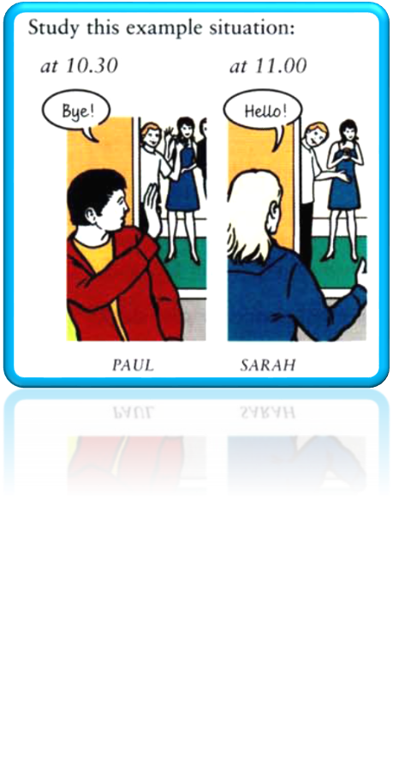
Study this example situation:
Sarah went to a party last week. Paul went to the party too but they didn't see each other. Paul went home at 10.30 and Sarah arrived at 11 o'clock.
So:
When Sarah arrived at the
party, Paul wasn't there. He had gone home.
Had gone is the past perfect (simple):

Slide 13



Past perfect use :
Sometimes we talk about something that happened in the past:
Sarah arrived at the party.
This is the starting point of the story. Then, if we
want to talk about things that happened before this
time, we use the past perfect (had ... ):
Past perfect Past simple Now

Slide 14
Example :
When Sarah arrived at the party, Paul had already gone home.
When we got home last night, we found that
somebody had broken into the flat.
Karen didn't want to come to the cinema with us
because she had already seen the film.

Slide 15

Past perfect use :
The past perfect expresses an activity that was completed before another activity or time in the past.
Sam had already left when Ann got there.
1st Sam left
2nd Ann got there
But
Sam left when Ann got there.
1st Ann got there.
2nd Sam left.

Slide 16
Example :
Sam had left before Ann got there.
Sam left before Ann got there.
After the guests had left, I went to bed.
After the guests left, I went to bed.
* If either before or after is used in the sentence, the past perfect is often not necessary because the time relationship is already clear.

Slide 17
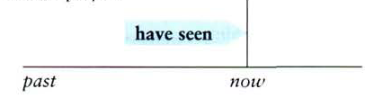
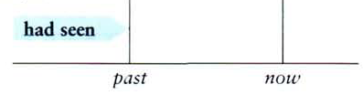
Had done (past perfect) is the past of have done (present perfect).
present perfect
Who is that woman? I've
never seen her before.
We aren't hungry. We've just had lunch.
The house is dirty. They
haven't cleaned it for weeks.
past perfect
I didn't know who she was.
I'd never seen her before. (= before that time)
We weren't hungry. We'd
just had lunch.
The house was dirty. They
hadn't cleaned it for weeks.

Slide 18
Compare the past perfect (I had done) and past simple (I did):
A:'Was Tom there when you arrived?‘
B: 'Yes, but he went home soon afterwards.‘
Ann wasn't at home when I phoned. She was in London.
A:'Was Tom at the party when you arrived?'
B:'No, he had already gone home.‘
Ann had just got home when I
phoned. She had been in London.

Slide 19
Exercise
Read the situations and write sentences from the words
in brackets:
1. You went to Jill's house but she wasn't there. (she/go/out)
She had gone out.
2. You went back to your home town after many years. It wasn't the same as before. (it/change/a lot)
It had changed a lot.
3. I invited Rachel to the party but she couldn't come.
(she/arrange/to do something else)
She had arranged to do something else.
4. I offered Sue something to eat but she wasn't hungry.
(she/just/have/breakfast)
She had just had breakfast.

Slide 20
Read the situations and write sentences ending with before. Use the verb given in brackets.
Exercise
1.The man sitting next to me on the plane was very nervous. It was his first flight.
(fly)
2. A woman walked into the room. She was a complete stranger to me.
(see)
He had never flown before.
I had never seen here before

Slide 21
Put the verb into the correct form, past perfect (I had done etc.) or past simple (I did etc.).
Exercise
1.'Was Tom at the party when you arrived?‘
'No, he …………. (go) home.‘
2. I felt very tire when I got home, so I…….…..
(go) straight to bed.
3. The house was very quiet when I got home. Everybody……… (go) to bed.
had gone
went
had gone

